Slide 1
DDSAnalytics “Why Did You Quit?”
By
Team Variance
https://github.com/bdelahoussaye/CaseStudy2

Slide 2
Title: Why Did You Quit?
Team Variance Members:
Terry Johnson
Steven Cocke
Brandon de la Houssaye

Slide 3
Presentation Outline
Business Objectives
Data Sourced
Methodology
Evaluation/Results
Summary

Slide 4
Business Objectives
Team Variance was engaged by DDSAnalytics (“Client”) to perform an exploratory data analysis (“EDA”) in order to facilitate Client’s goal of predicting employee turnover.
Client provided Team Variance with certain employee data in order to conclude on the following:
(At least) top three factors that contribute to turnover
Learnings about any job role specific trends
Meaningful insights (TBD) provided from the sourced data
Final deliverables include presentation (this file) as well as supporting analysis/documentation (via github repo)
Outside of scope: predictive models (this engagement merely provides insight on trends). Such models would be covered under future engagements

Slide 5
Data Source
Source Data File: “CaseStudy2-data.csv”
Source data file provided by DDSAnalytics and is based on available employee data
Source Data File Summary:
Classes ‘tbl_df’, ‘tbl’ and 'data.frame': 1470 obs. of 35 variables
[summary statistics of source data file are provided in the appendix]

Slide 6
Methodology
The workflow was performed as follows:
Structure the raw data*
Imported raw data into R Studio
Renamed columns to usable text
Formatted column (variables) to proper data types as needed
Perform preliminary analysis the structured data
Remove observations for employees under 18 years of age*
Observed descriptive statistics for seven variables including the observable distribution for two of the seven.
Observed frequency results for Gender, Education, and Occupation as well as the counts of management positions.
Perform deeper analysis based on results of preliminary analysis (not in order)
Ran summary stats for the data set where filtering was done for attrition variable.
Separated focus group (those that left) based on levels of experience in order to gain insights into what may be driving employee decisions
Considered relationships between Age, Income, Gender, Satisfaction metrics (Environment, Job, and Relationship) and attrition
Explored insights into job type
*The document does not cover these steps. For reference, please see relevant github repo.

Slide 7
Evaluation/Results
Prelim Analysis
Pulled the descriptive statistics for Monthly Income, Age, Education, Years in Current Role, Distance from Home, Job Level, and Percentage Salary Hike (in order)
(Monthly Income)
Min. 1st Qu. Median Mean 3rd Qu. Max.
1009 2911 4919 6503 8379 19999
(Age)
Min. 1st Qu. Median Mean 3rd Qu. Max.
18.00 30.00 36.00 36.92 43.00 60.00
(Education)
Min. 1st Qu. Median Mean 3rd Qu. Max.
1.000 2.000 3.000 2.913 4.000 5.000
(Years in Current Role)
Min. 1st Qu. Median Mean 3rd Qu. Max.
0.000 2.000 3.000 4.229 7.000 18.000
(Distance from Home)
Min. 1st Qu. Median Mean 3rd Qu. Max.
1.000 2.000 7.000 9.193 14.000 29.000
(Job Level)
Min. 1st Qu. Median Mean 3rd Qu. Max.
1.000 1.000 2.000 2.064 3.000 5.000
(Percentage Salary Hike)
Min. 1st Qu. Median Mean 3rd Qu. Max.
11.00 12.00 14.00 15.21 18.00 25.00

Slide 8
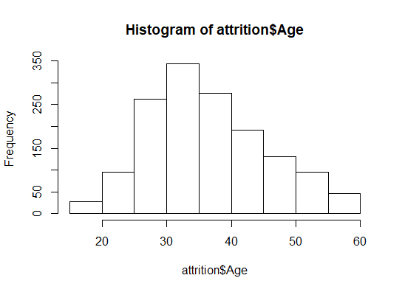
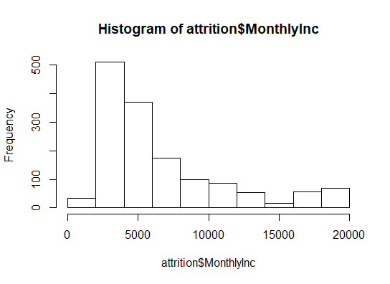
Evaluation/Results
Prelim Analysis
b. Observed Histograms from two of these variables

Slide 9
Evaluation/Results
Prelim Analysis
c. Observed frequencies for Gender, Education, Job Roles, and Management
What does the preliminary analysis tell us?
Pyramid structure (less than 20% are management) and the pay skews left (also observe the difference between mean and median in Monthly Income)
Education: 50% of the workforce has a bachelor or better. There is a significant portion of the workforce that does not have a bachelor degree.
Pay increases: the difference between mean and median tell us that pay increases are not discerning to high performers, or, at the very least, an overwhelming majority of the workforce are deemed neither poor or exceeding.
Activity: Job titles indicate significant amounts of product and R&D. This plus the distance from the office could be indicators of job mobility.
Take-Aways: The pyramid nature of the workforce would indicate that reasons for employees leaving may need to account for different groups of employees.

Slide 10
Evaluation/Results
Deeper Analysis
First, ran summary stats where the attrition variable was filtered. Mean and Median results (where applicable) were observed and all comparisons were between “Yes” vs. “No or Total” [Note “No or Total” results were generally not discernable].
The average or median age was approximately 10% lower.
The distance from home was on average 15% greater; with a median of 30% greater (implying that there was a skew of individuals that may have left because they lived a great distance from work).
The average Environment Satisfaction score was approximately 10% lower. There was no discernable change in median implying that there were extreme results (in terms of a low score).
The median Job Level was half of that for the overall sample implying the employees were “lower on the totem pole”. The average decrease was only 21% which implies that there were a handful of exits by senior level employees (but the majority seemed to be more junior).
The average monthly income was 25% less, with a median of 35% less. This would further imply that the majority of exits were junior level employees. Cannot determine is if pay was the driving force (i.e., did people leave for more money)
The median number of companies worked was 1, which is half of that for the overall sample. However, the average number of companies worked was actually 10% greater than the overall sample. The implication is that the majority of employees that left had only worked at this company.
The total working years was on average 27% less, and the average years at the company was 27% less as well. Additionally, the median number of years at the company was 40% less, and the median total working years was 30% less. This implies further support as to the level and experience of the employees that left (being lower).
Take-Aways: Given the above results, it makes sense to break the attrition group (“Yes”) into sub-groups to understand if there are different factors leading to those that leave based on seniority.

Slide 11
Evaluation/Results
Deeper Analysis
b. After separating the “Yes” attrition group based on working years (total sample median is approximately 11 years, so that was the separator), we observed the following:
Variables such as age, job level, monthly income, total working years and years at company were already controlled for in filtering at 11 years, so differences in the results was already taken into account.
We do observe, however, that the number of companies worked has a median of approximately one (which is about half of the total sample) whether the group has more or less than 11 years of experience. On the other hand, both sub-groups show an average of companies worked greater than overall sample. This indicates that for handful of the employees, they may be characterized as ‘serial job hoppers’ where the large majority of employees have worked at very few locations. It is important to note, this may not be a variable considered for predicting whether an employee leaves because there may be a large number of employees that did not leave (even with similar results in number of companies worked).
Another interesting variable is distance from home. The more senior sub-population exhibited results similar to the sample which would indicate that distance/commuting did not factor into their decision. Of course, the implies that the Junior sub-group did in fact live further than the greater population.
The final interesting observation from the sub-groups was the Environment Satisfaction score. The Junior group exhibited a median result similar to the larger group, with a average result slightly lower (similar to the overall “Yes” group). This implies that there were a handful of low scores by the Junior group but the larger number of observations aligned with the overall group. But for the Senior sub-group, the average score and the median score were much lower than the overall group.
Take-Aways: Given the variables considered, the Environment Satisfaction score appeared to be meaningful factor for those with more experience. Overall, pay may play a very big role, but that may be due to experience as opposed to those leaving getting paid less.

Slide 12
Evaluation/Results
Deeper Analysis
c. Further analyzed the data to focus on gender as well as job role.
After observing counts of the broader sample as well as the “Yes” group, we can compare and contrast the perceived role of gender as well as job roles.
For the broader sample, women count at 588 out of 1470, and for the “Yes” group women count at 87 out of 237. So while it appears that a high overall level that women may have may leave, the difference is generally not significant.
For job roles, we observe that laboratory technicians account for the largest number of job roles that leave, followed by sales executives, research scientists, and then sales representatives. Where for the larger population, the larger job groups are sales executives, research scientists, laboratory technicians, and then manufacturing directors in order. What does this indicate?
Being a sales representative is an important factor in attrition. Out of 83 people in the sample, 33 left.
Laboratory technicians are plentiful and they have left in large numbers. This is due to perhaps seeking advancement outside of the company (to a role beyond technician).
Sales executives and research scientists are, obviously, highly sought after roles, but this doesn’t imply people in those roles would not leave (perhaps because they are also in high demand in the market).
Take-Aways: The sales representatives are likely going to leave and anything with “scientist” or “executive” is probably in high demand outside the company. For lab technicians, further analysis would likely be required.
The following plots consider the relationship between income, age, and gender, as well as income, job role, and attrition. We also observe environment satisfaction by pay and attrition, as well as job role, income, education level and attrition. Lastly, we consider the role of satisfaction scores on attrition rates.

Slide 13
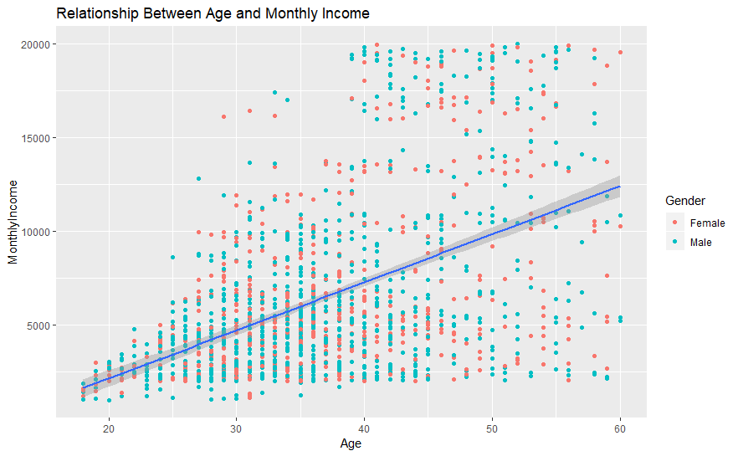
Evaluation: Relationship between Age and Monthly Income by Gender
Take-Aways: There are no meaningful insights here with respect to the variables considered except that there is significant variance in income across any given age.

Slide 14
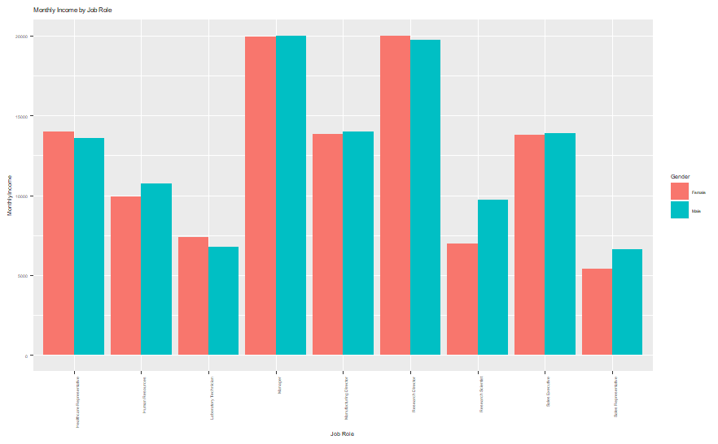
Evaluation: Relationship of Job Title to Monthly Pay by Gender
Take-Aways: There are no meaningful insights here except that pay between men and women is relatively even.

Slide 15
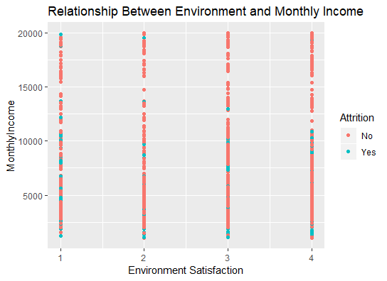
Evaluation: Relationship of Environment Satisfaction to Monthly Pay by Attrition
Take-Aways: There are no meaningful insights here except that pay between men and women is relatively even.

Slide 16
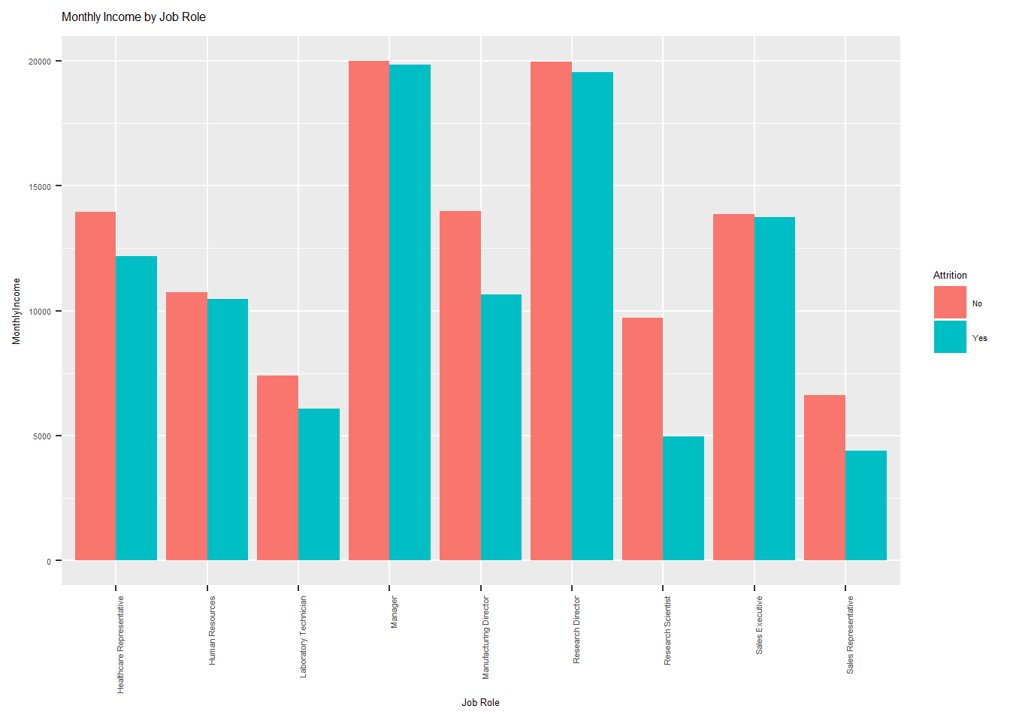
Evaluation: Relationship of Job Title to Monthly Pay by Attrition
Take-Aways: For the roles with higher attrition, there seems to be real pay difference between those that stay and leave.

Slide 17
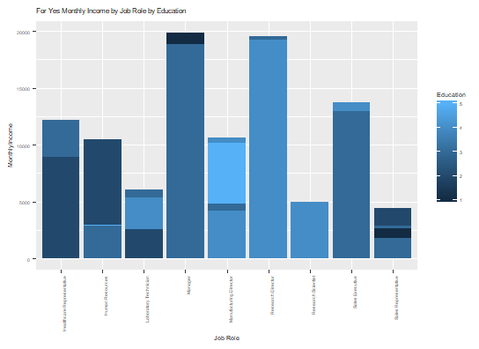
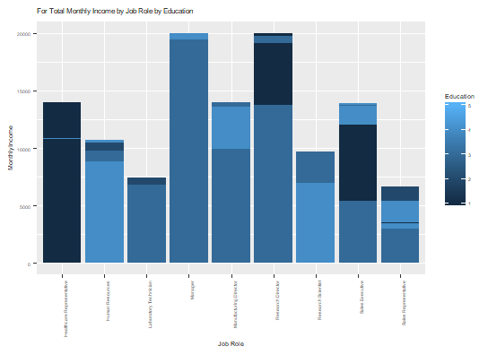
Evaluation: Relationship of Job Title to Education by Monthly Pay (YES and Total)
Take-Aways: Focus on the roles where the bar is shorter and a different color. The shorter bar shows that income was lower (driver); but…why: the education prevents them from achieving success or perhaps they are in high demand. Represents positions to be investigated.

Slide 18
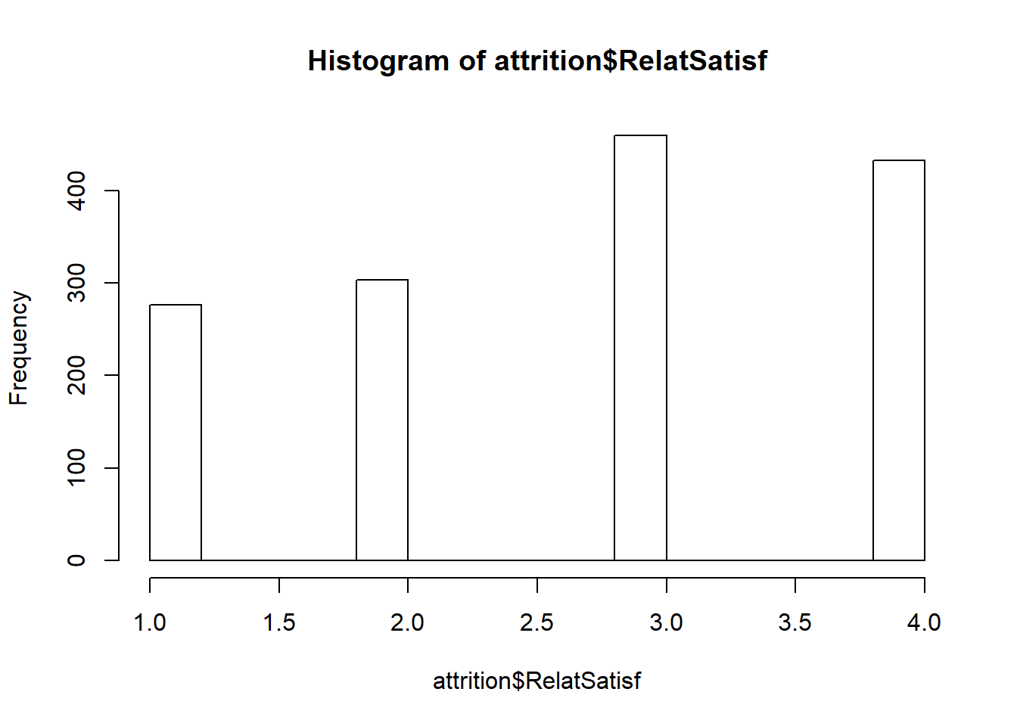
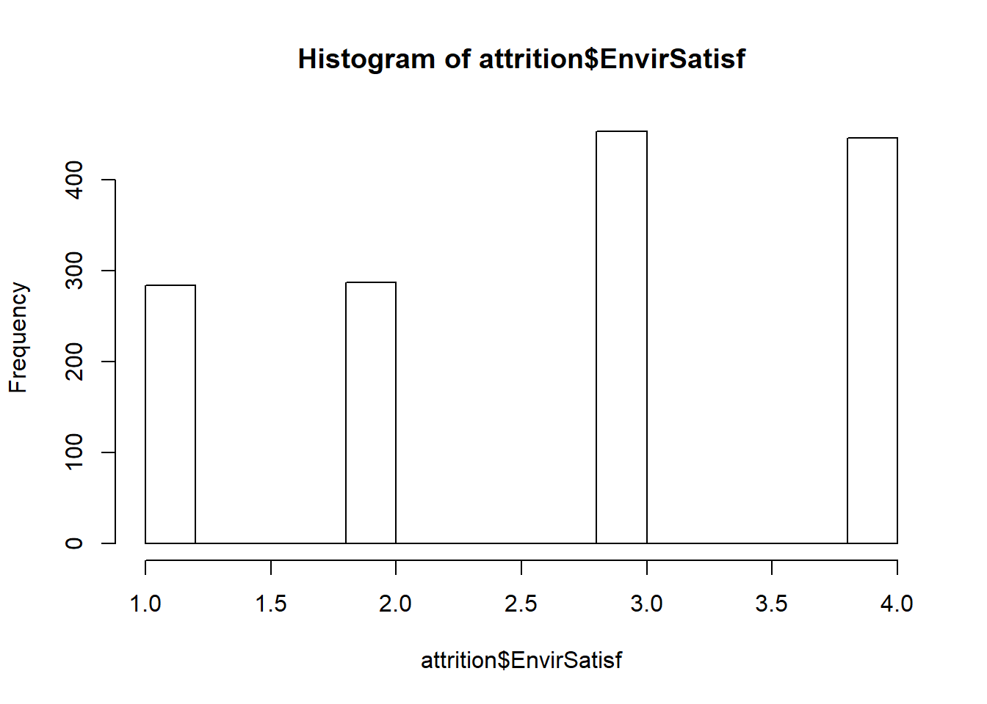
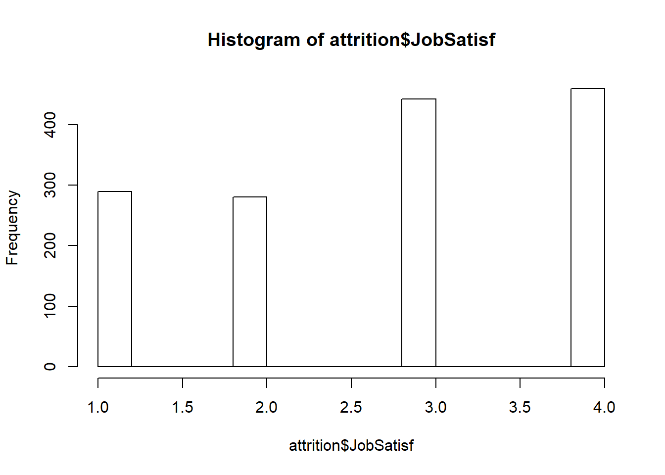
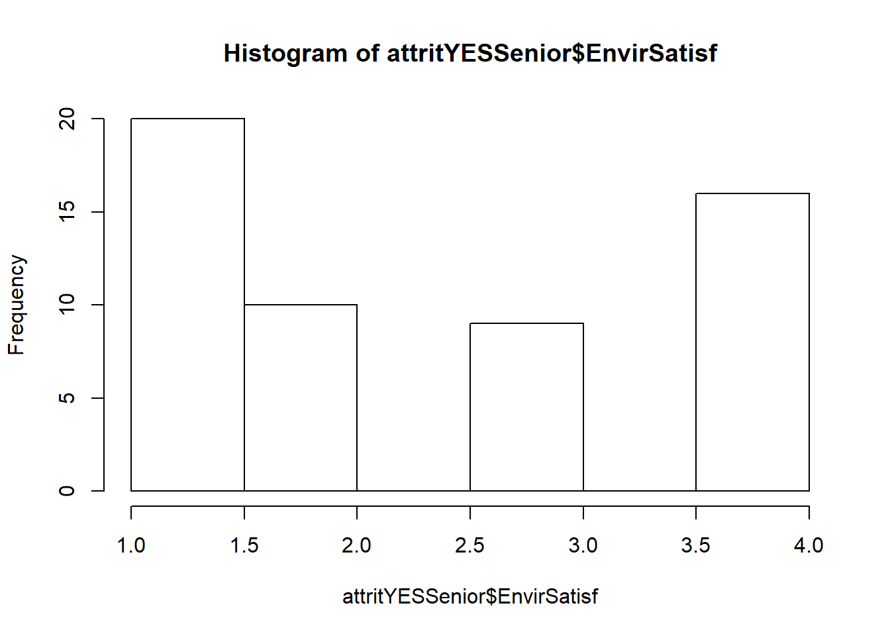
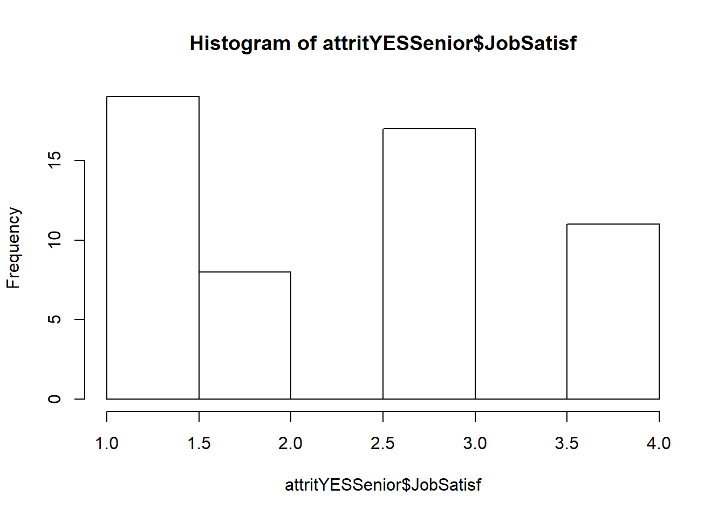
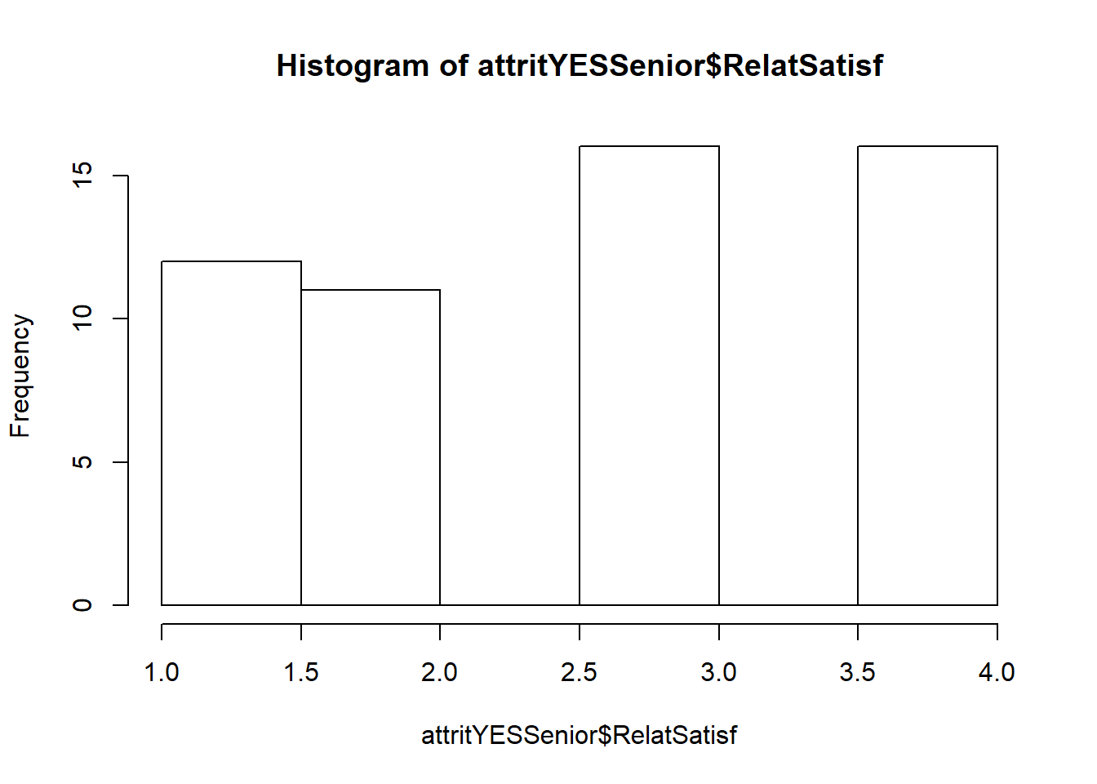
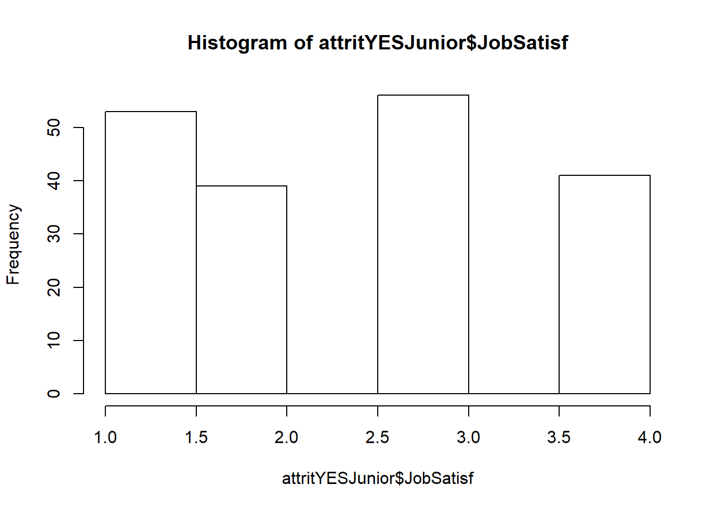
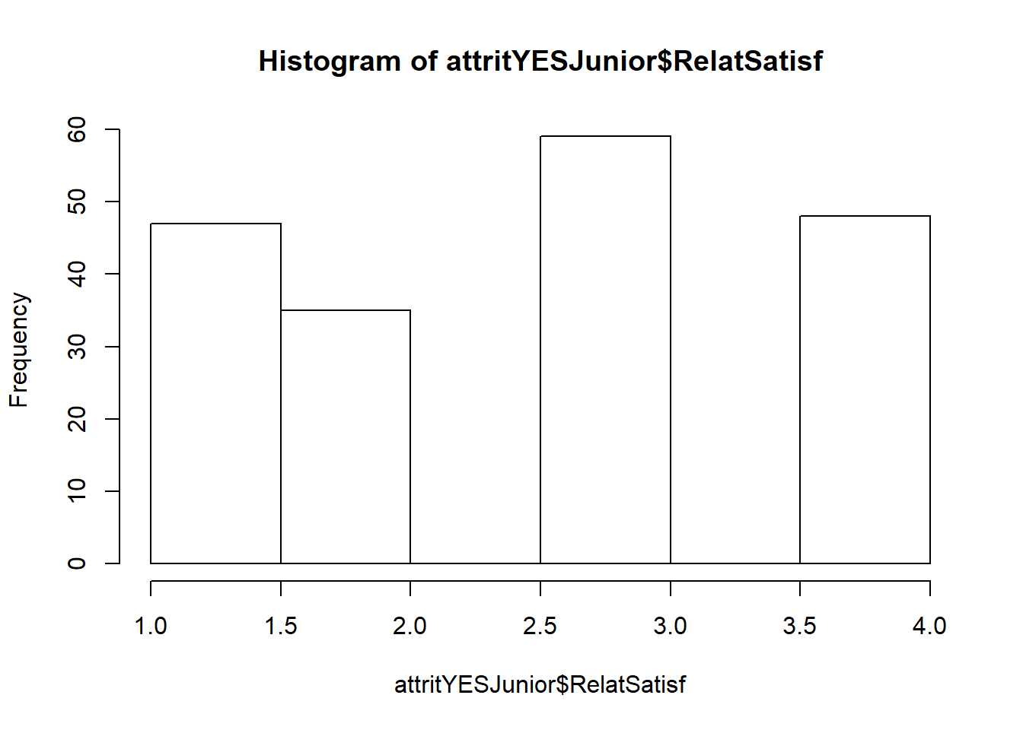
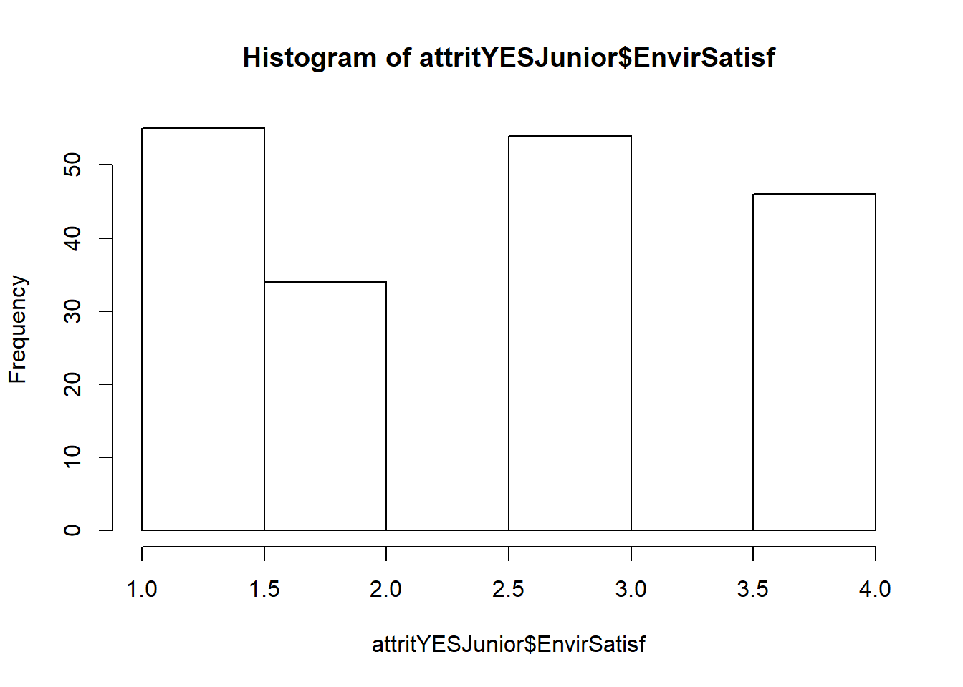
Evaluation: Satisfaction

Slide 19
Summary
After analyzing the results, we can conclude the following patterns:
Of note, the company stats can conclude that the workforce is divided between the experienced, compensated, and educated. Therefore, the analysis must take into account differences in employee groups.
The significant factors that aligned with attrition are:
Experience
Job Role
Pay
Experience: (those will more than 11 years working indicated lower Satisfcation scores on Environment and Job). Those will less than 11 years focused on commute.
Job Roles: such as research scientist, sales representatives, lab techs, and sales exits accounted for a significant portion of those that left. Sales reps accounted for a very high amount in particular.
Pay: Those that left were generally paid less

Slide 20
Summary (cont’d)
After analyzing the results, we can conclude the following patterns:
The impact of a factor for any person or sub-group needs to take into account education, commute, and satisfaction scores (for Environment and Job)
Example: someone with more than 11 years of experience may not have a longer commute, but they generally showed signs of displeasure with Satisfaction scores. Whereas, this was not the case for those with less than 11 years of experience.
Example: research scientists were generally paid less for those who left, but those that left had higher education levels indicating that they are displeased at performing the same work for less pay as those less qualified.
Example: someone with less than 11 years of experience may have a commute time greater than the sample and that may cause them to leave.

Slide 21
Conclusion
Team Variance Advice is as follows
Collect and consider the following data:
Boss Satisfaction: there is a rule of thumb that the number one reason people leave is because of the boss. We need to prove/disprove this notion.
Job Role and pay at next job
Predictive models need to be built specific to employee sub-groups. From the data provided, we chose the median number of years worked. It can also be done on a basis of management versus non-management.
Pay needs to be taken into account especially by job role and education level.
Satisfaction surveys should be taken into account for certain employee sub-groups, and perhaps expanded to account for boss specific attributes.
Commuting time may factor in as well, especially for employees with less experience.

Slide 22
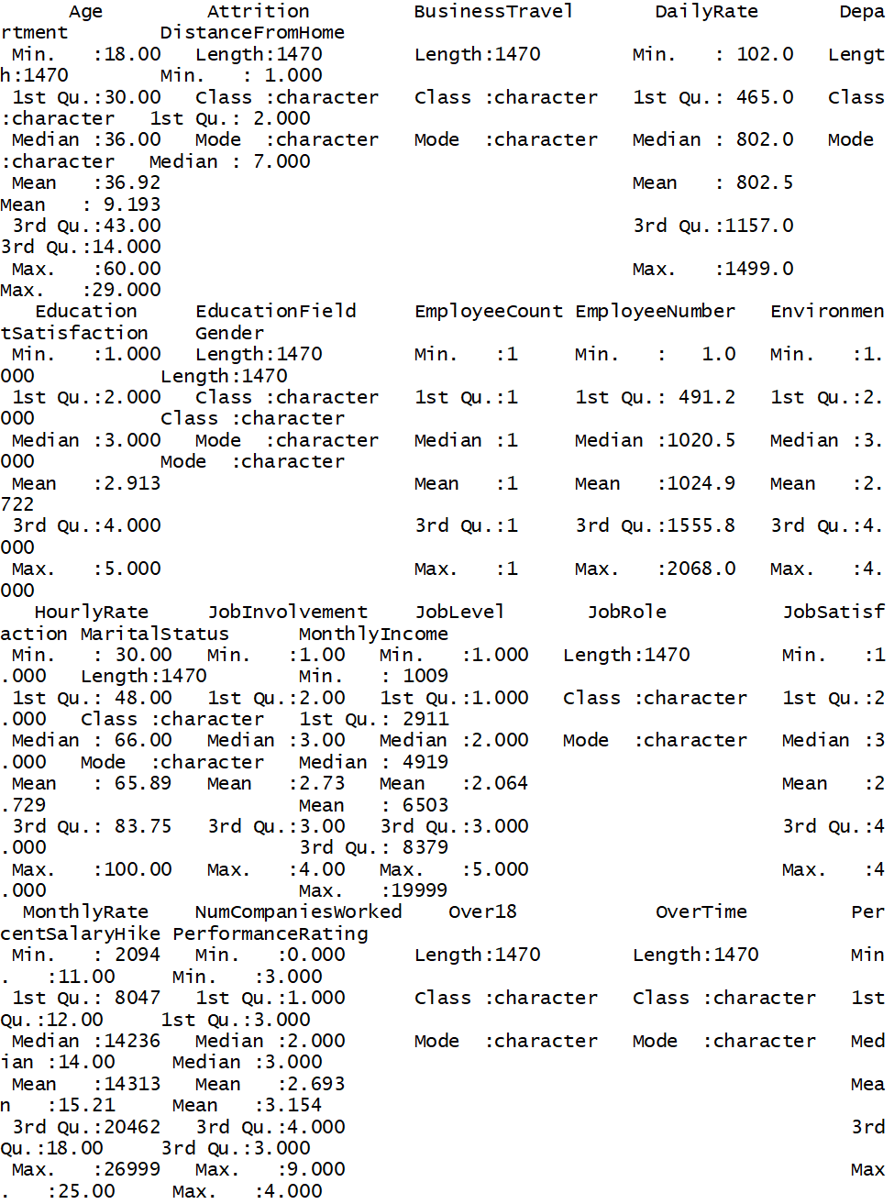
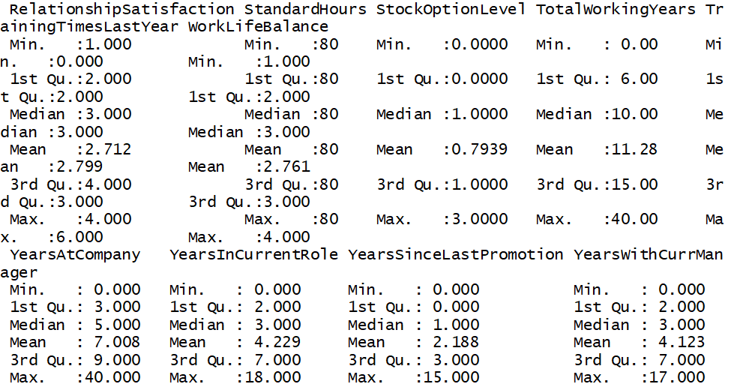
Appendix: Data Source - Summary Statistics

